Slide 1
Introduction to the Raspberry Pi Pico
AlbertaLoop Mechatronics Showdown 2025
Steven Knudsen, PhD PEng
knud@ualberta.ca

Slide 2
Outline
Raspberry Pi Pico and Pico W overview
Setting up for MicroPython
Setting up for C/C++
What about Rust?
Wokwi.com and Pico

Slide 3
Sources for the talk
Coming soon…
github.com/StevenKnudsen/AlbertaLoop2025Workshop

Slide 4
Assumptions
You know how to program in Python
You have a Pico

Slide 5
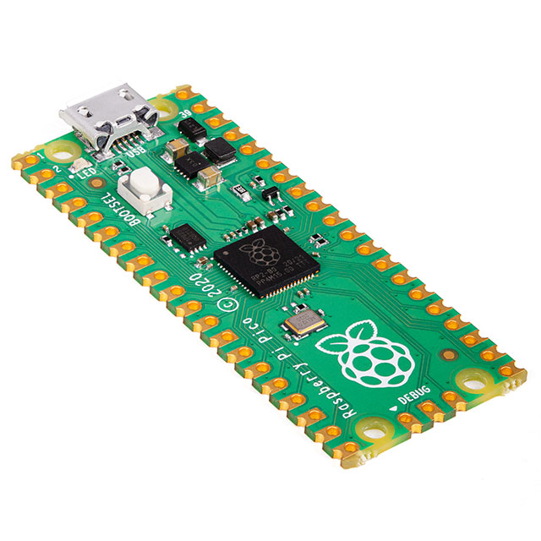
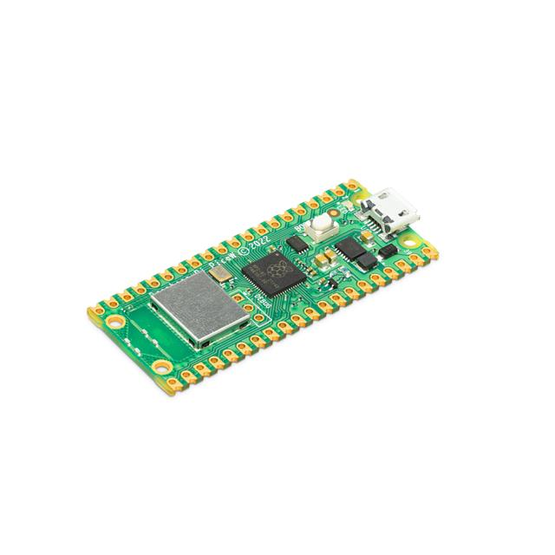
Raspberry Pi Pico and Pico W
Raspberry Pi Pico is a low-cost, high-performance microcontroller board with flexible digital interfaces. Key features include:
RP2040 microcontroller chip designed by Raspberry Pi in the United Kingdom
Dual-core Arm Cortex M0+ processor, flexible clock running up to 133 MHz
264 kB of SRAM, and 2MB of on-board flash memory
USB 1.1 with device and host support
Low-power sleep and dormant modes
Drag-and-drop programming using mass storage over USB
26 × multi-function GPIO pins
2 × SPI, 2 × I2C, 2 × UART, 3 × 12-bit ADC, 16 × controllable PWM channels
Accurate clock and timer on-chip
Temperature sensor
Accelerated floating-point libraries on-chip
8 × Programmable I/O (PIO) state machines for custom peripheral support
Images from digikey.ca

Slide 6
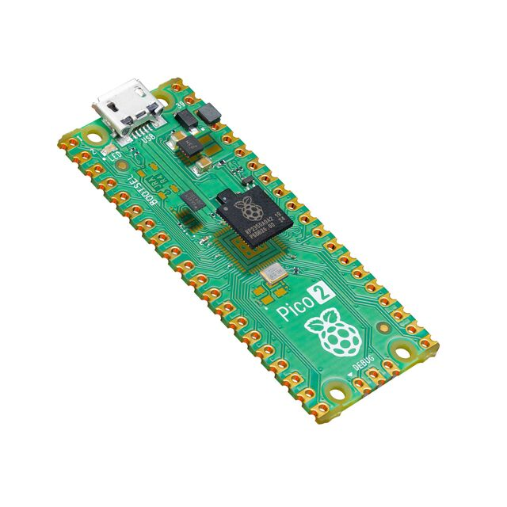
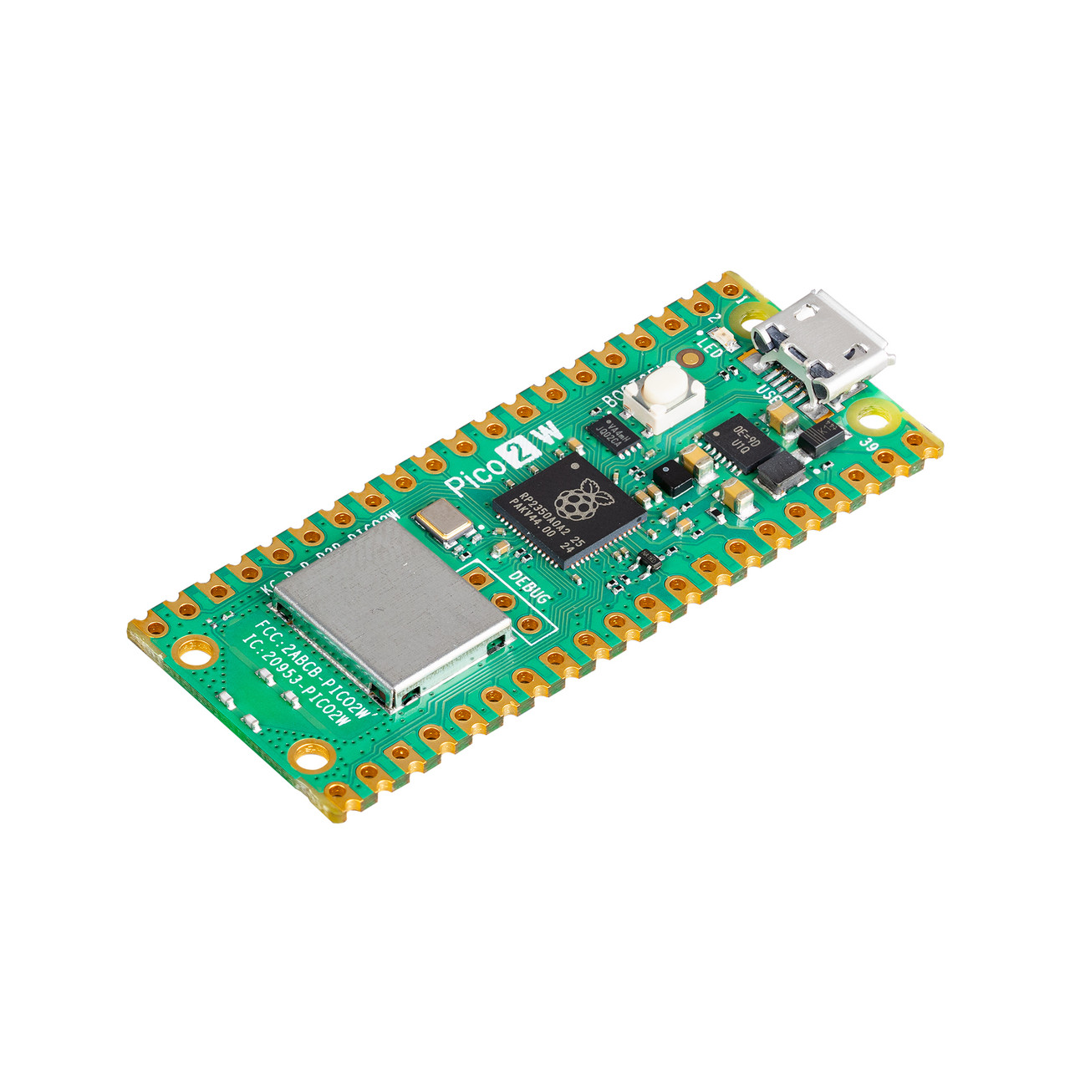
Raspberry Pi Pico 2 and Pico 2 W
Raspberry Pi Pico 2 updates the Pico with:
Dual Arm Cortex-M33 or dual Hazard3 RISC-V processors @ 150MHz
520 KB on-chip SRAM
2.4GHz 802.11n wireless LAN and Bluetooth 5.2 (Raspberry Pi Pico 2 W only)
Software- and hardware-compatible with Raspberry Pi Pico 1
Robust and fully documented security features:
ARM TrustZone for Cortex-M
Optional boot signing, enforced by on-chip mask ROM, with key fingerprint in OTP
Protected OTP storage for optional boot decryption key
Global bus filtering based on Arm or RISC-V security/privilege levels
Peripherals, GPIOs, and DMA channels individually assignable to security domains
Hardware mitigations for fault injection attacks
Hardware SHA-256 accelerator
2 × SPI, 2 × I2C, 2 × UART, 24 × PWM, 3 x 12-bit ADC
1 × USB 1.1 controller and PHY, with host and device support
12 × PIO state machines
Open source C/C++ SDK, MicroPython support
RP2040 microcontroller chip designed by Raspberry Pi in the United Kingdom
Dual-core Arm Cortex M0+ processor, flexible clock running up to 133 MHz
264 kB of SRAM, and 2MB of on-board flash memory
USB 1.1 with device and host support
Low-power sleep and dormant modes
Drag-and-drop programming using mass storage over USB
26 × multi-function GPIO pins
2 × SPI, 2 × I2C, 2 × UART, 3 × 12-bit ADC, 16 × controllable PWM channels
Accurate clock and timer on-chip
Temperature sensor
Accelerated floating-point libraries on-chip
8 × Programmable I/O (PIO) state machines for custom peripheral support
Images from digikey.ca
and PiShop.ca

Slide 7
Pico & Pico W — Pico 2 & Pico 2 W
$CA6.10 & $CA9.15 $CA7.63 & $CA10.68
at mouser.ca

Slide 8
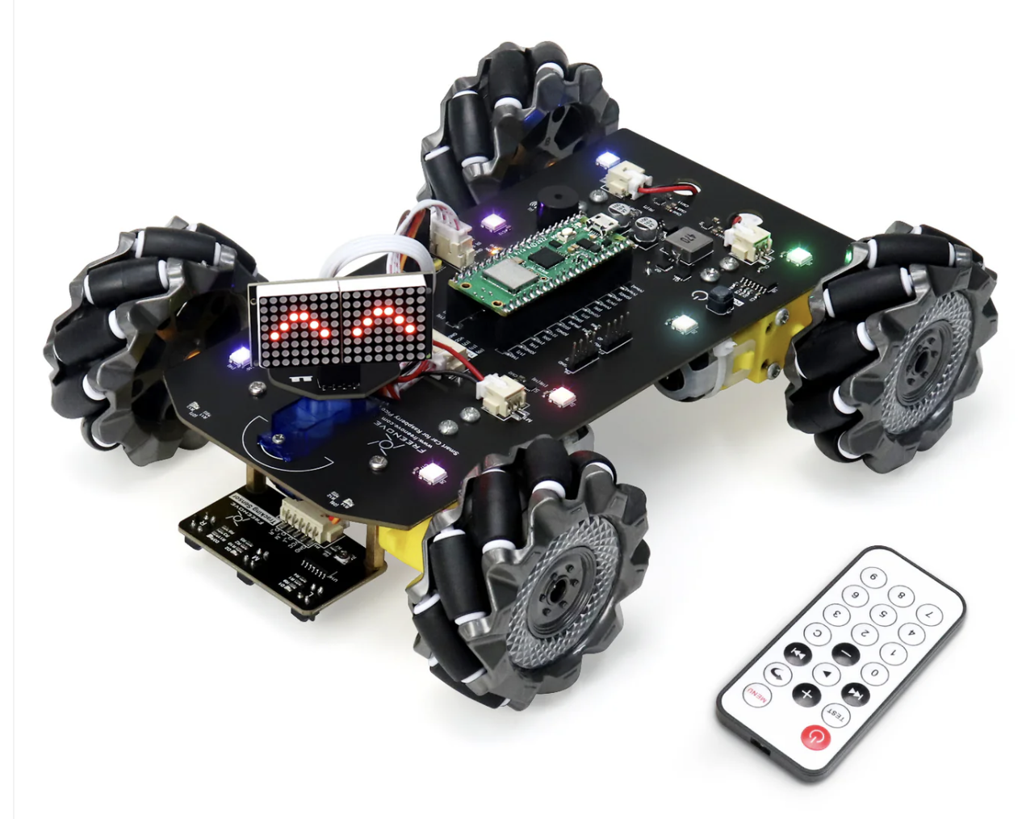
Pico will be core for Mechatronics

Slide 9
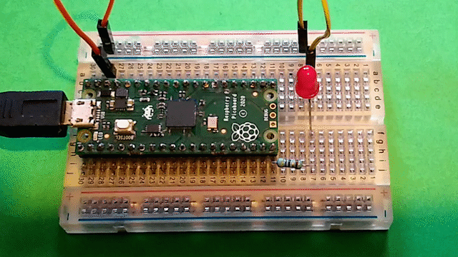
Getting started with the Pico - MicroPython
The main reference is a very good tutorial
https://projects.raspberrypi.org/en/projects/getting-started-with-the-pico/0

Slide 10
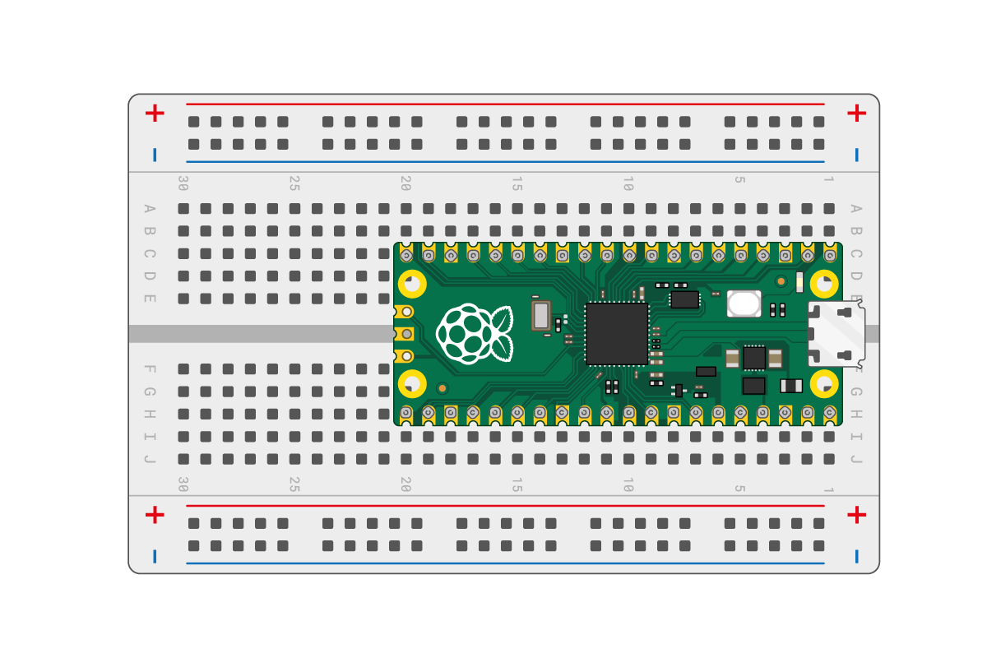
Pico on breadboard
https://projects.raspberrypi.org/en/projects/getting-started-with-the-pico/1

Slide 11
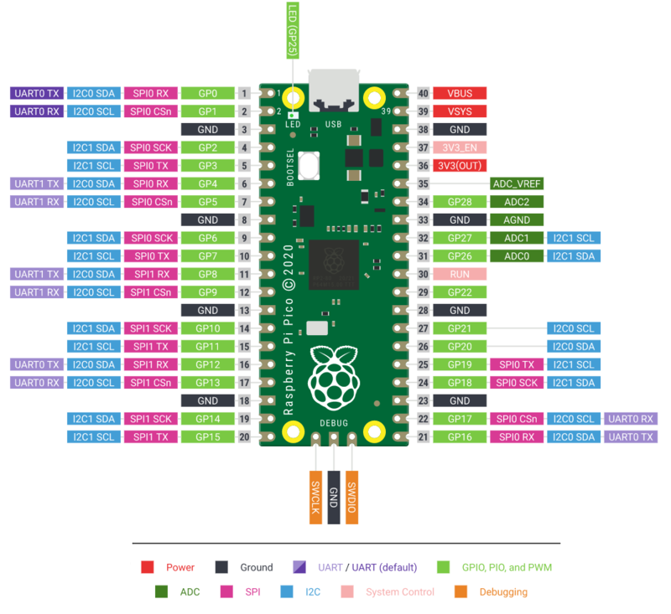
RPi Pico Pins

Slide 12
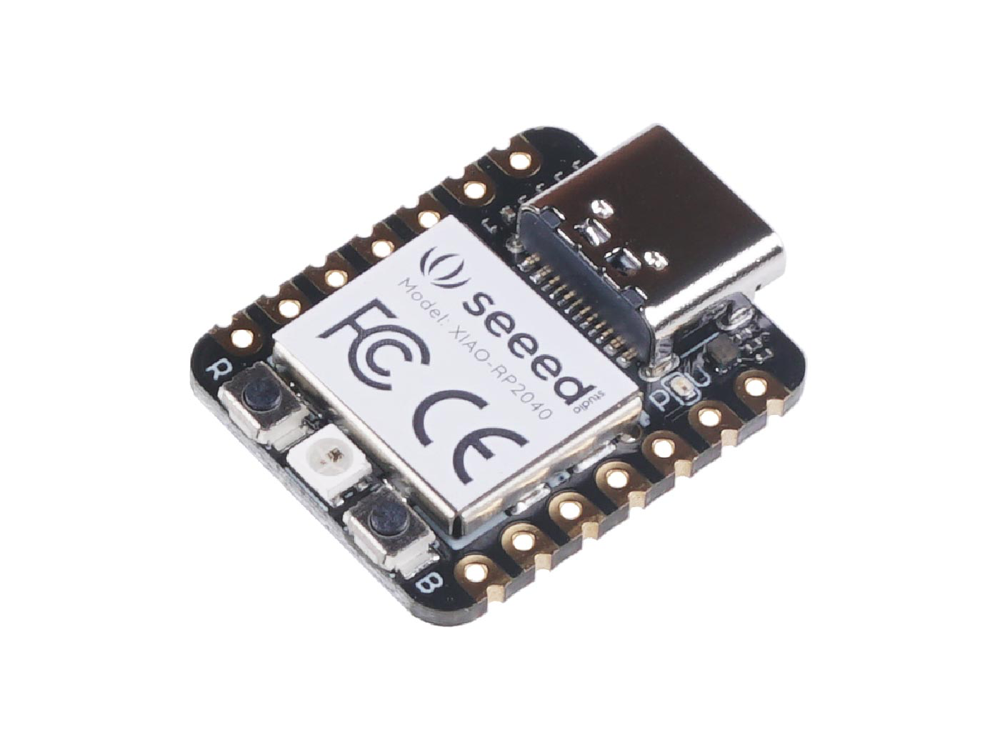
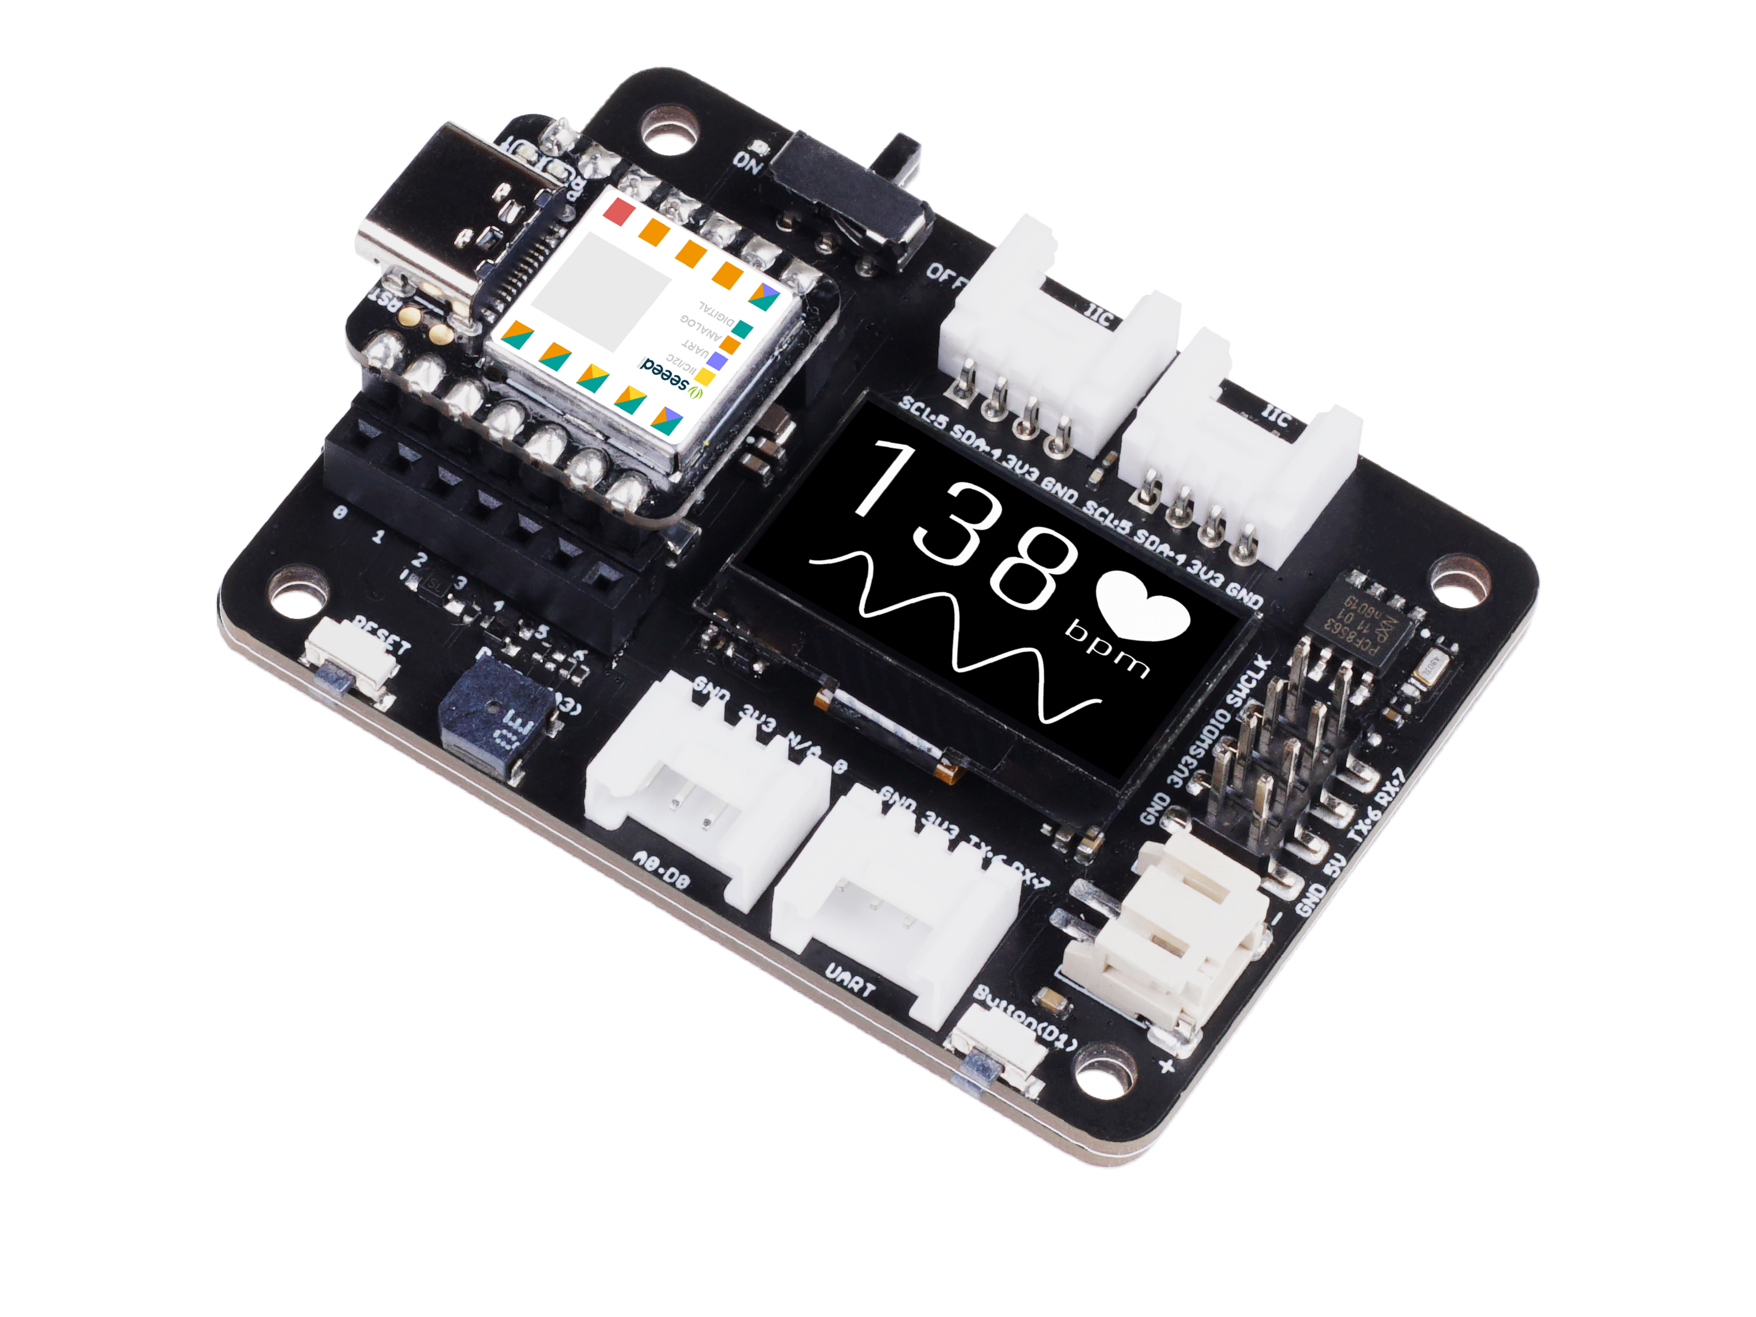
XIAO RP2040 and Expansion board

Slide 13
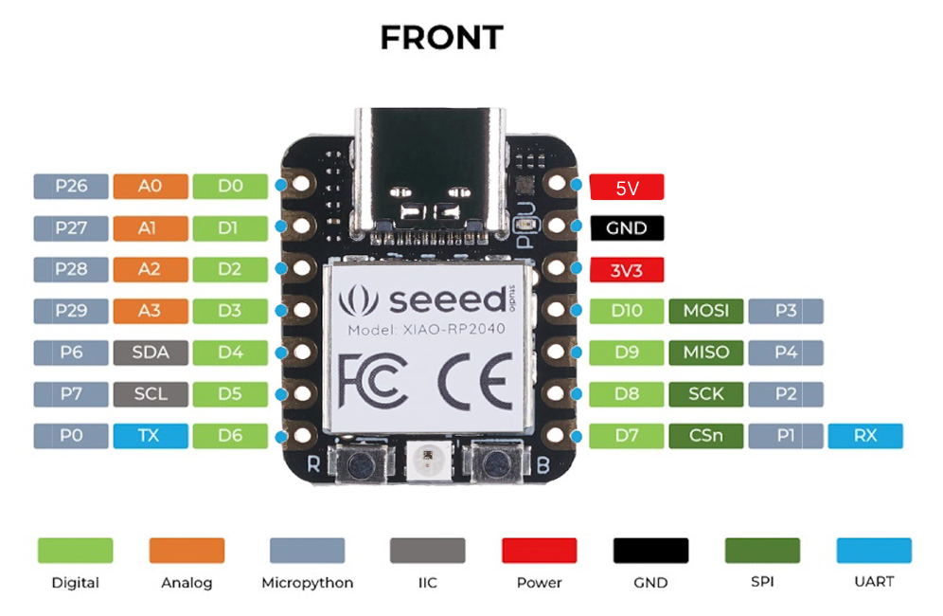
XIAO RP2040 Pins

Slide 14
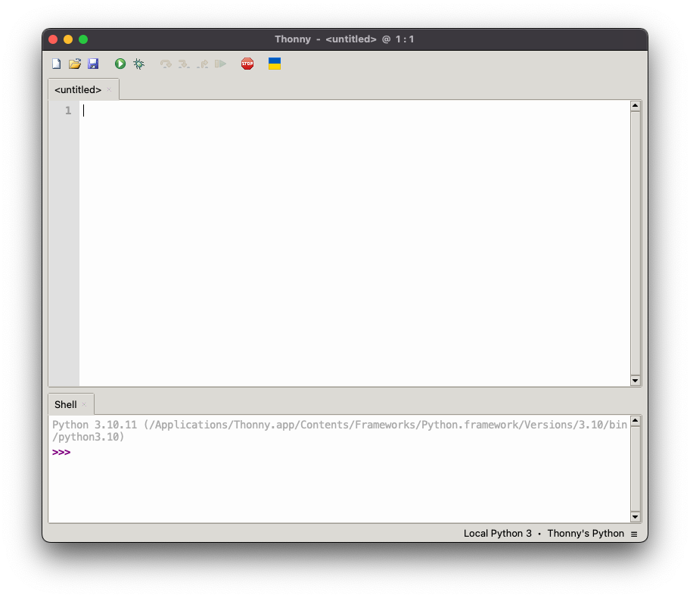
Install Thonny
(Win/Lin/macOS)
Notes:
This is Thonny, a beginner Python IDE. Happens to be running on a MacBook Pro, but same for other OSes

Slide 15
Pico in boot select (bootsel) mode
Unplug Pico from USB
Press and hold bootsel button
Plug Pico into USB and wait a few seconds
Release bootsel button
Open Thonny
https://wiki.seeedstudio.com/XIAO-RP2040/
https://projects.raspberrypi.org/en/projects/getting-started-with-the-pico/3

Slide 16
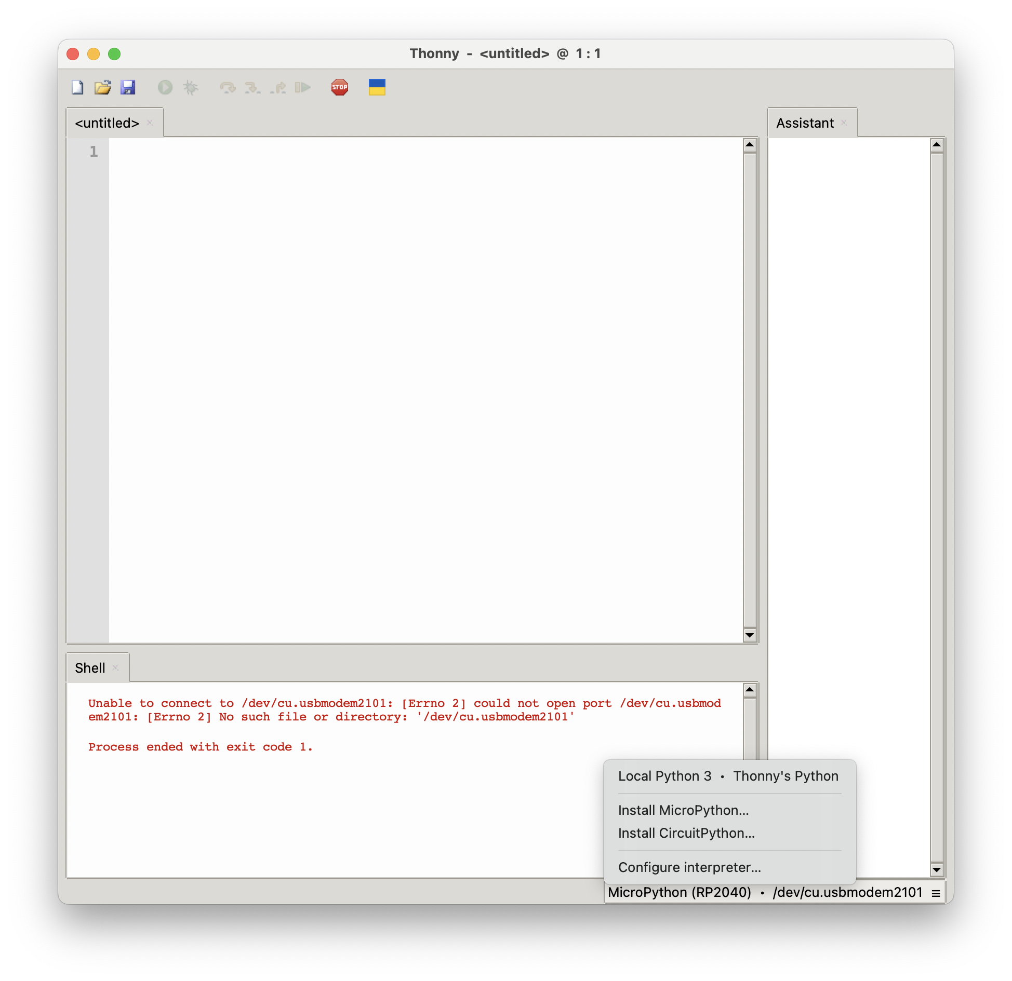
Install
MicroPython
Notes:
Open the hamburger menu in the lower right corner and select install micropython

Slide 17
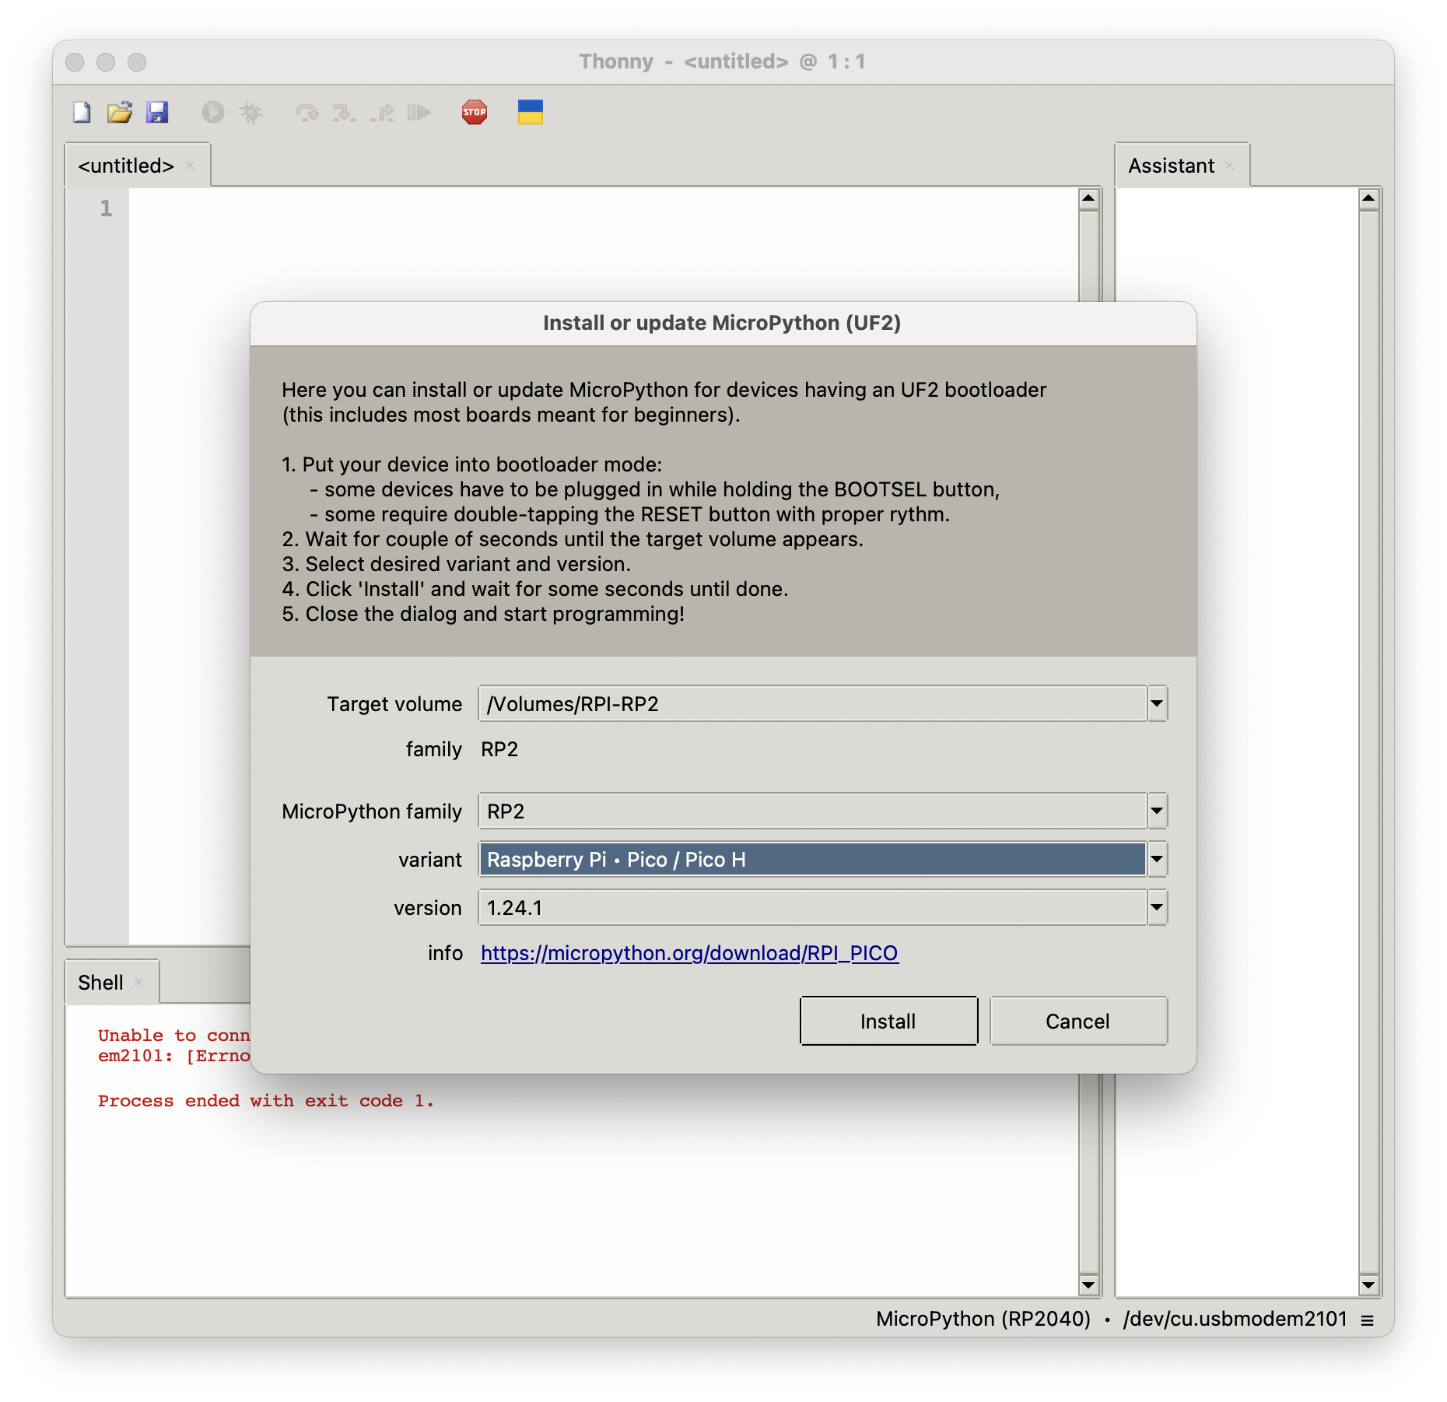
Install dialogue
Notes:
The RPi will disconnect when this is done, then reconnect

Slide 18
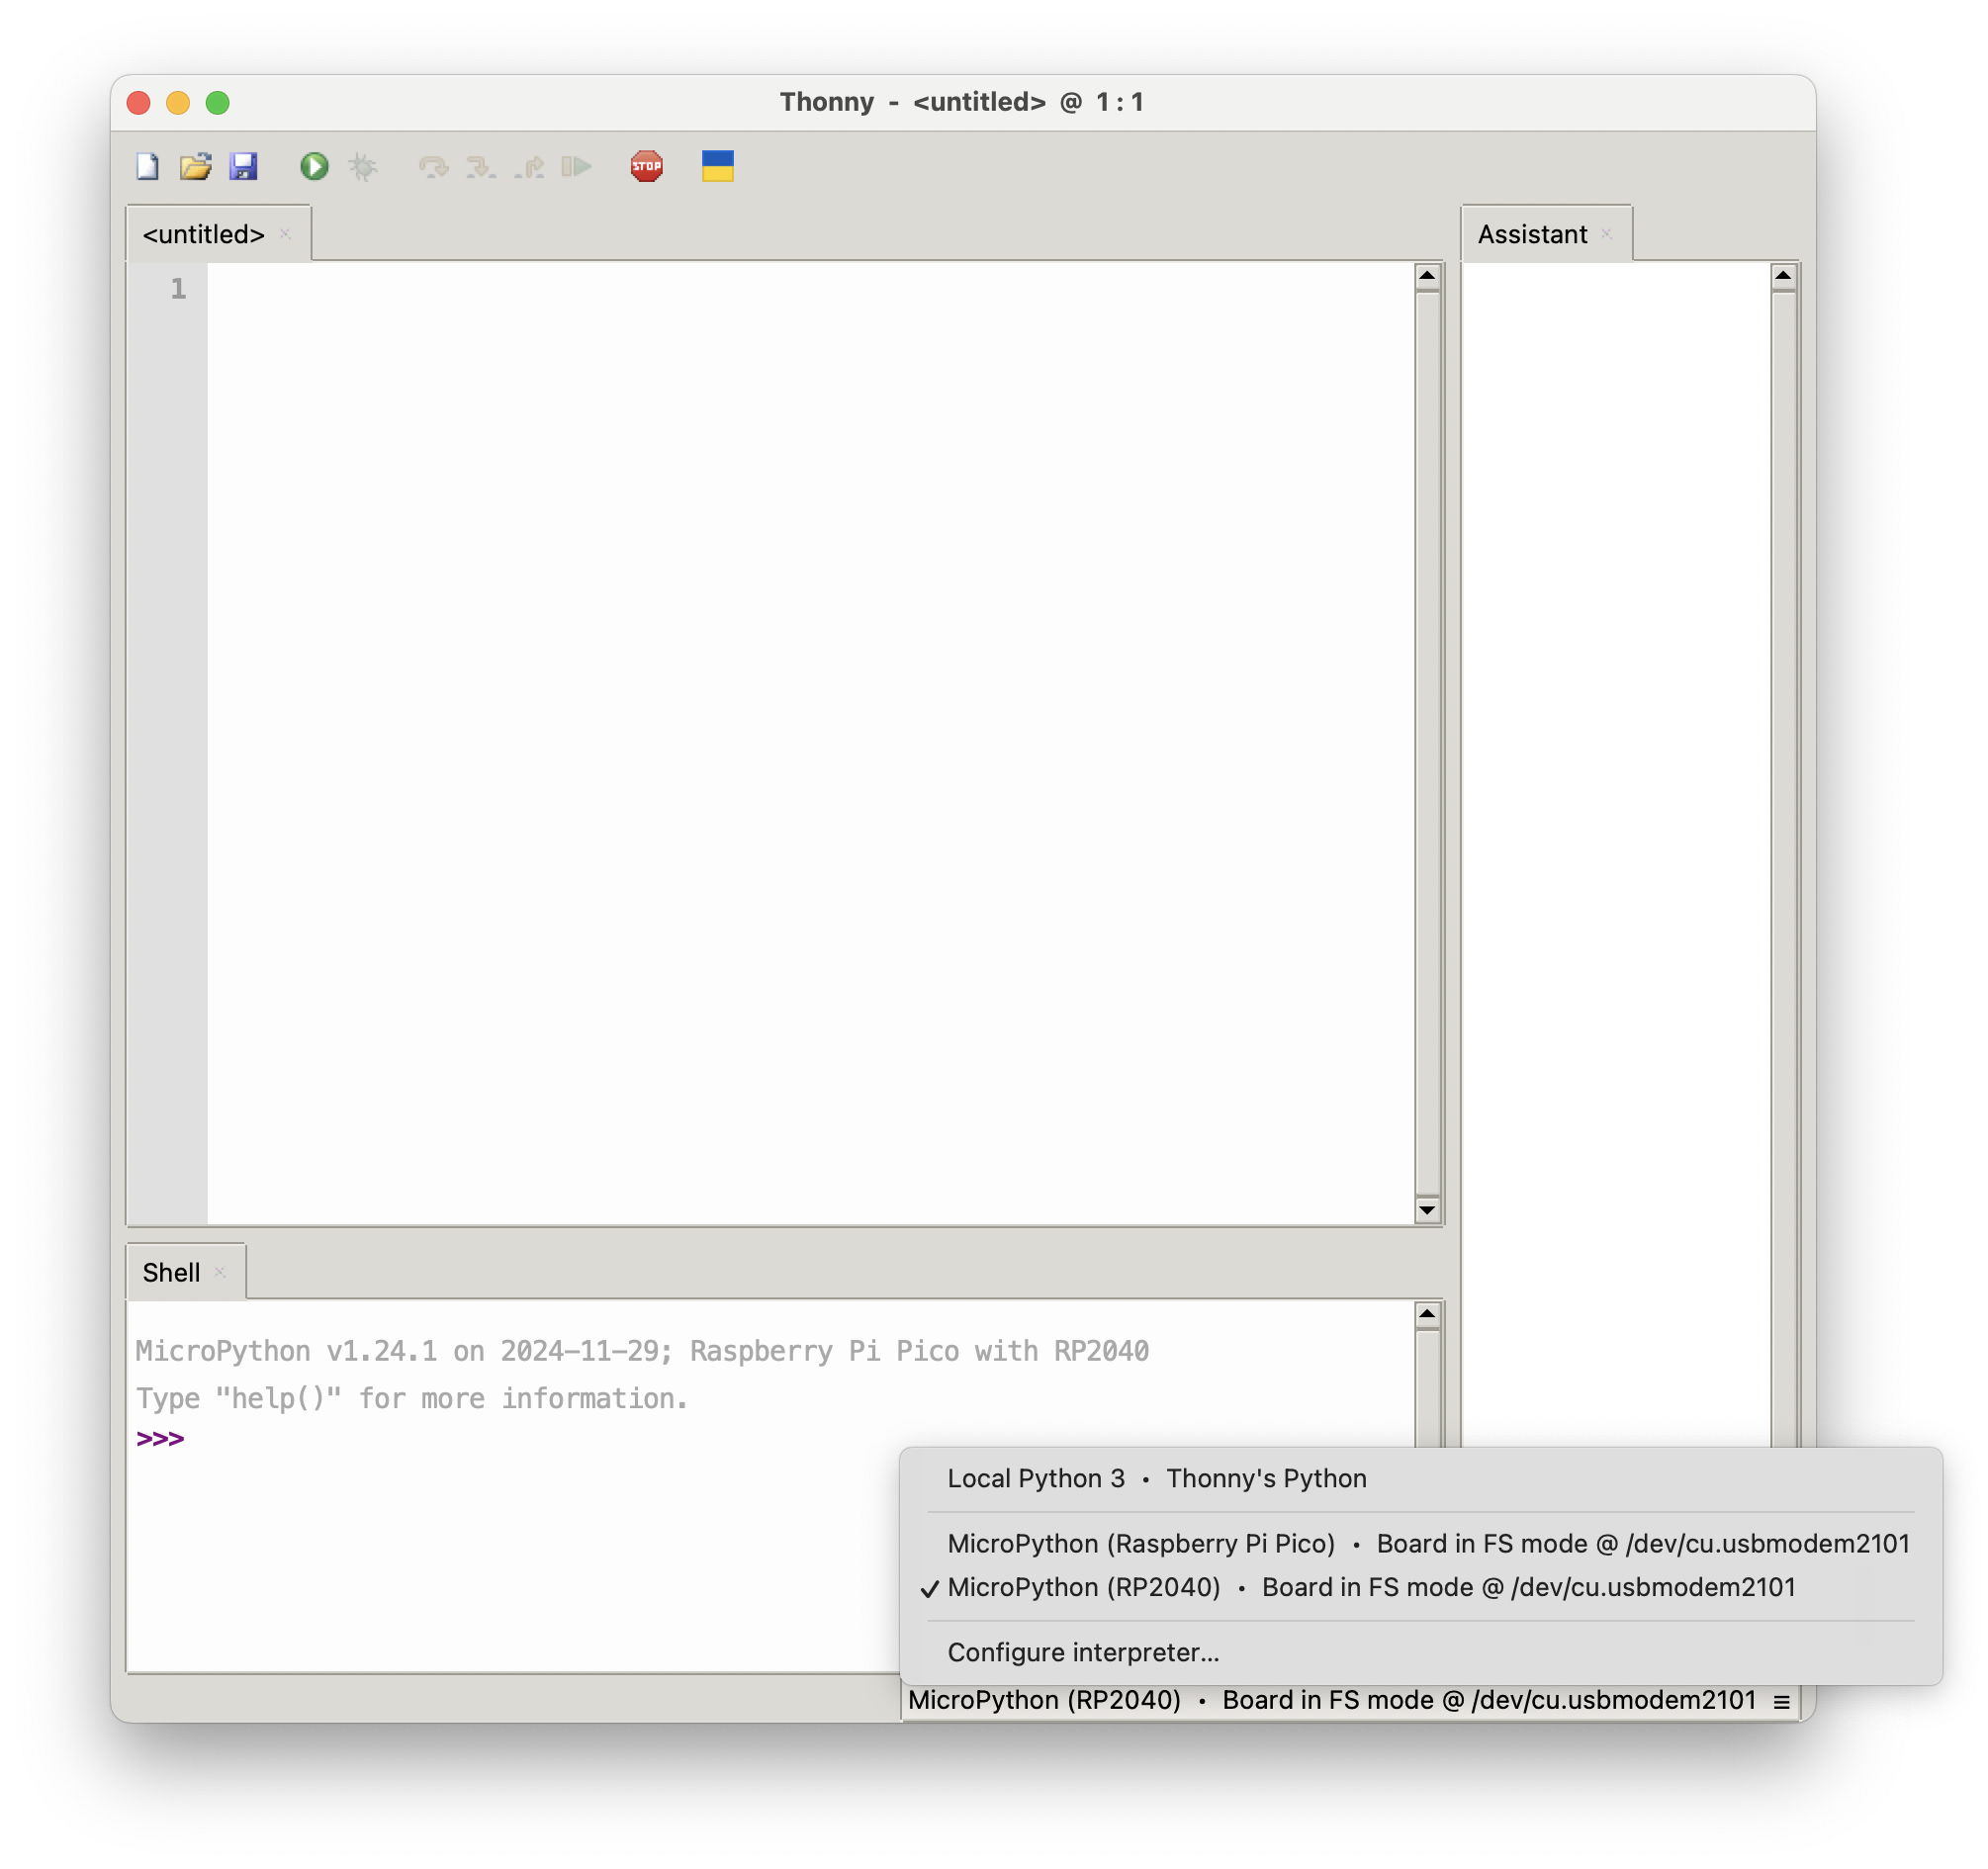
Connect
Notes:
We need to connect to the Pico. Again, open the hamburger menu. Notice these are both really the same, so it doesn’t matter which we choose.

Slide 19
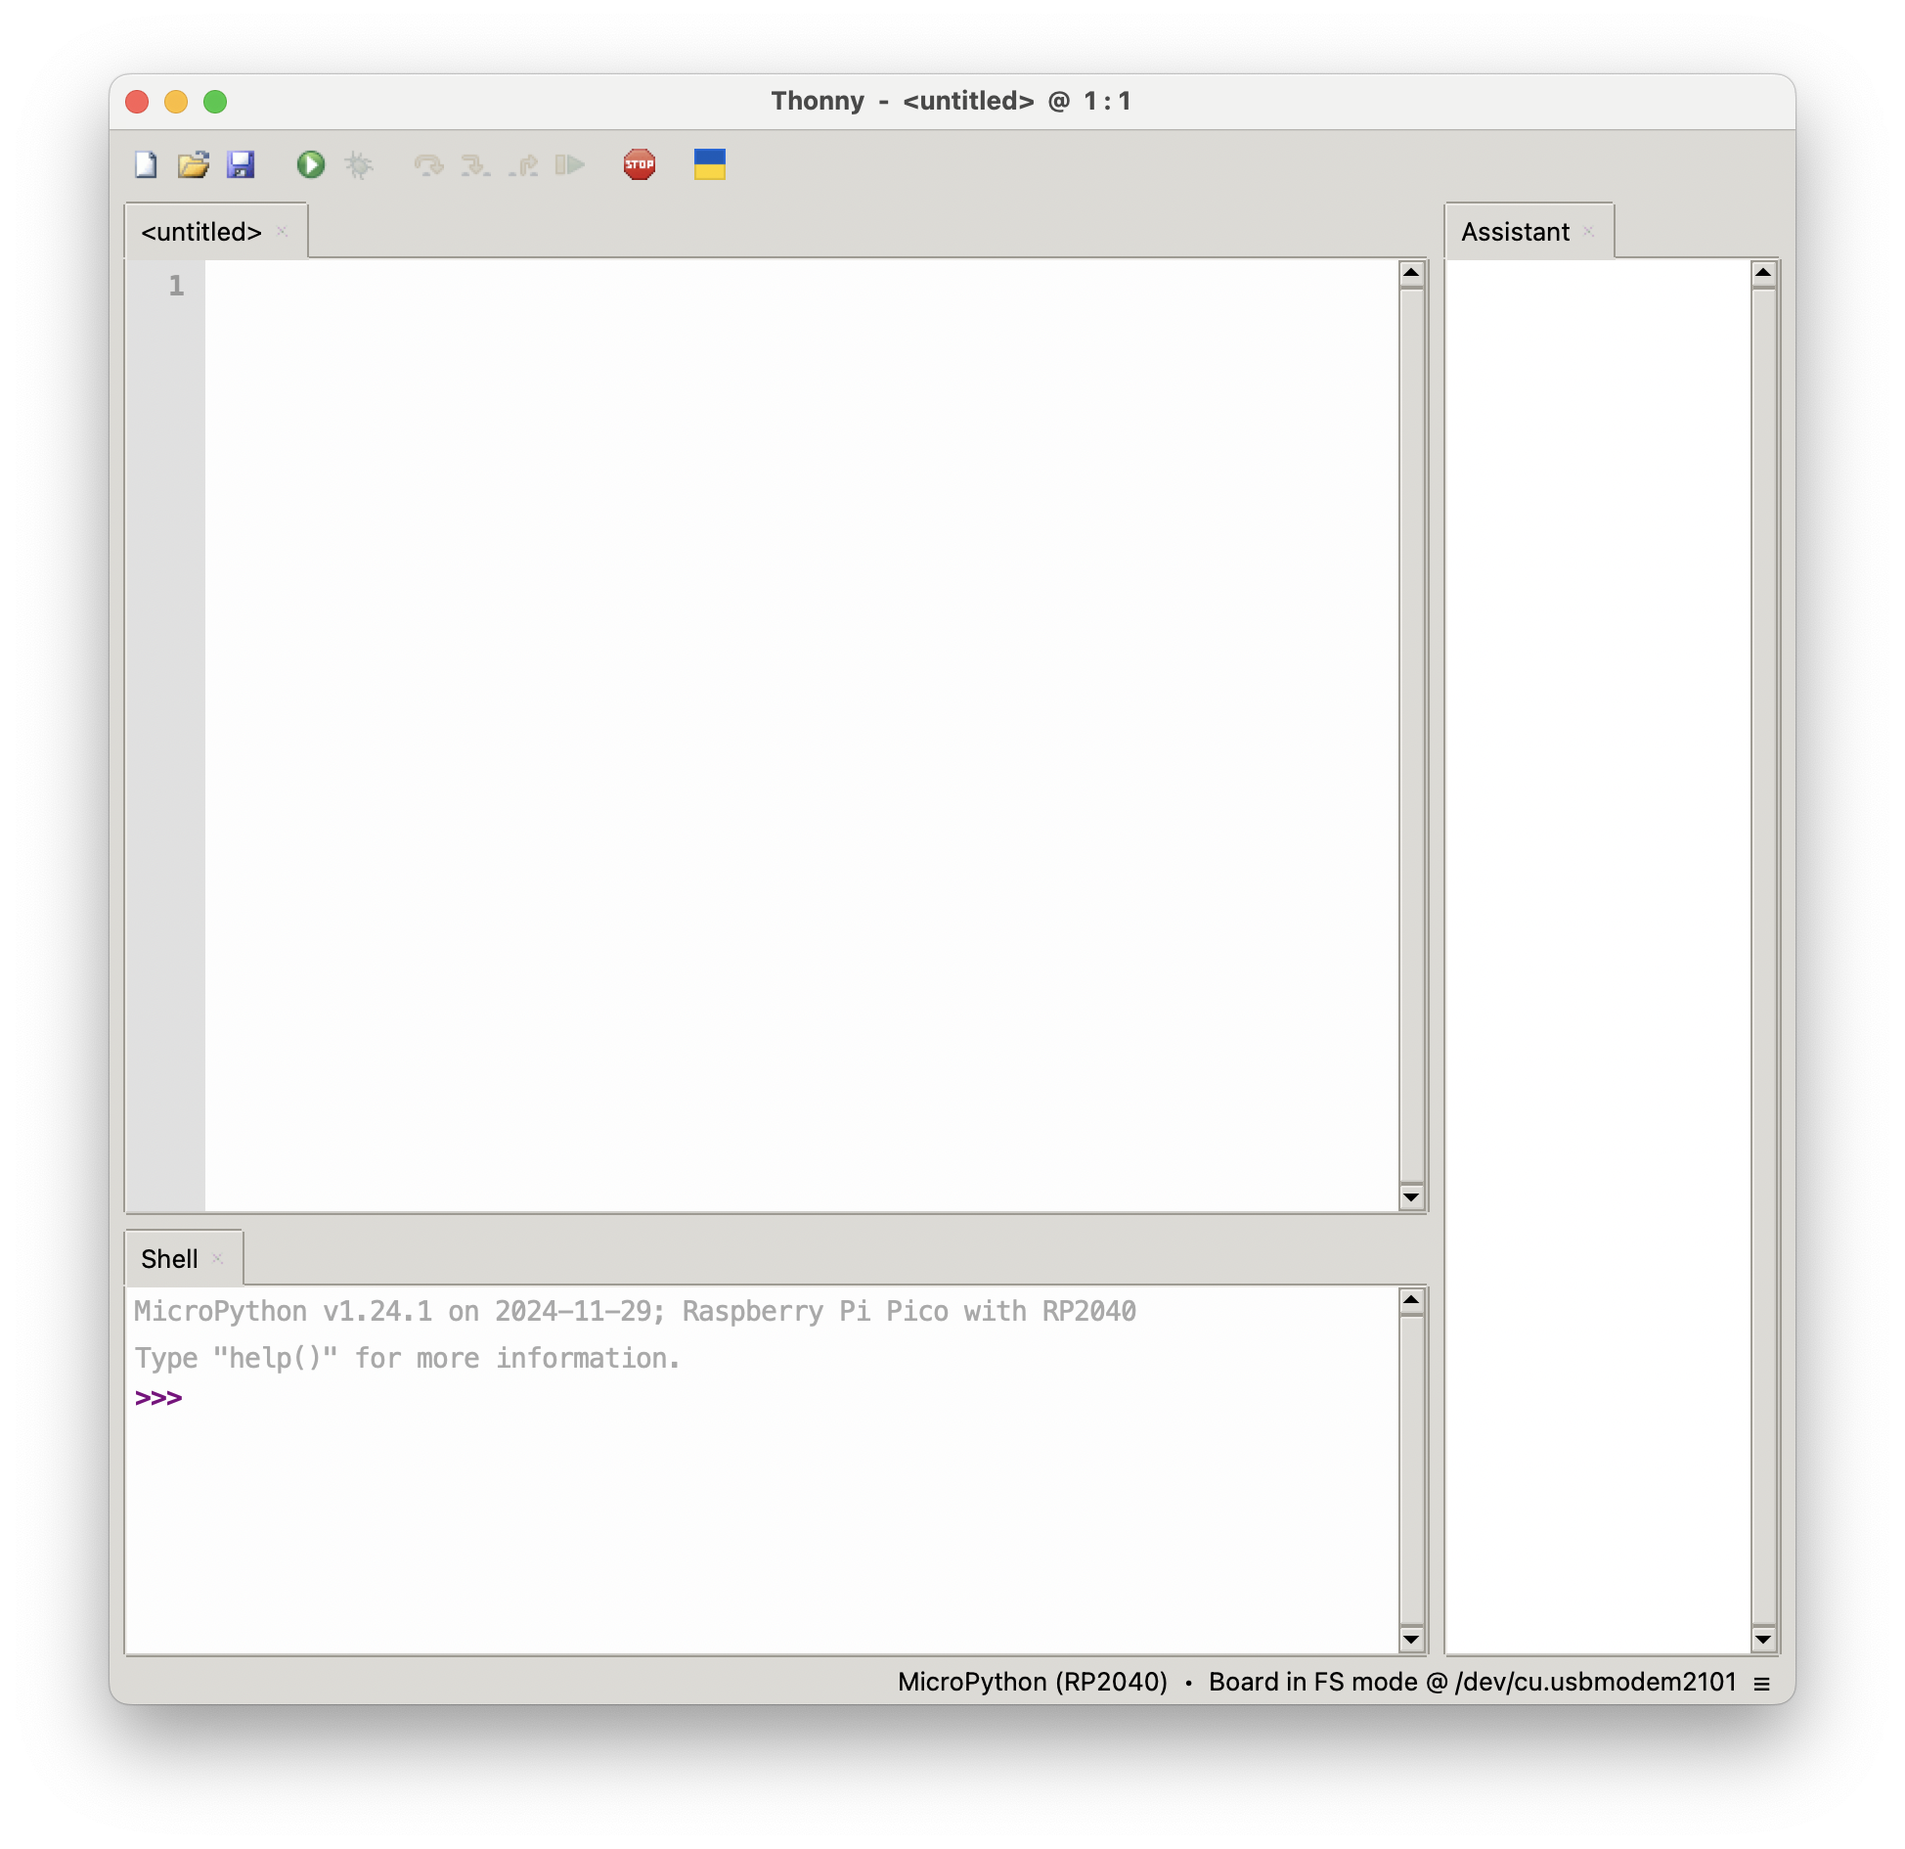

Slide 20
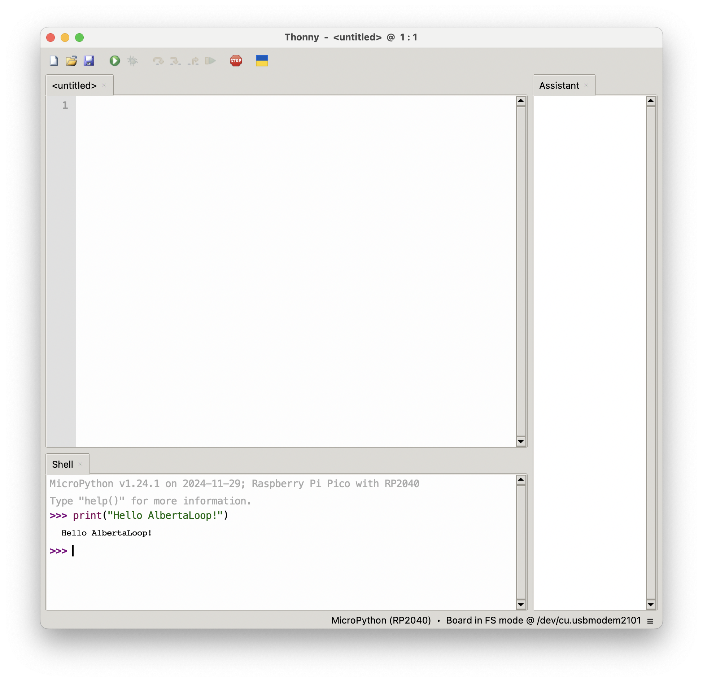
Success!

Slide 21
GPIOs
Lots of support for GPIO and other peripherals at MicroPython.org
Quick Reference for MicroPython is found at
https://docs.micropython.org/en/latest/rp2/quickref.html
Support for
HW Timers, GPIO, UART, PWM, ADC, SW SPI, HW SPI, SW I2C, HW I2C, I2S, RTC, WDT, OneWire, NeoPixel, APA106
… but probably not …

Slide 22
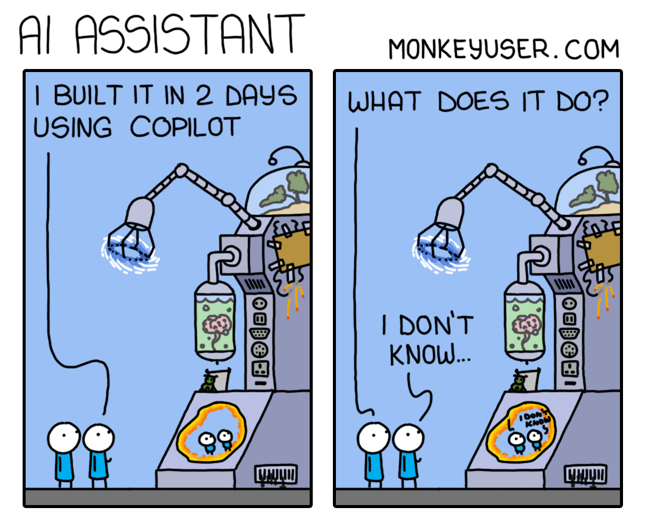
monkeyuser.com

Slide 23
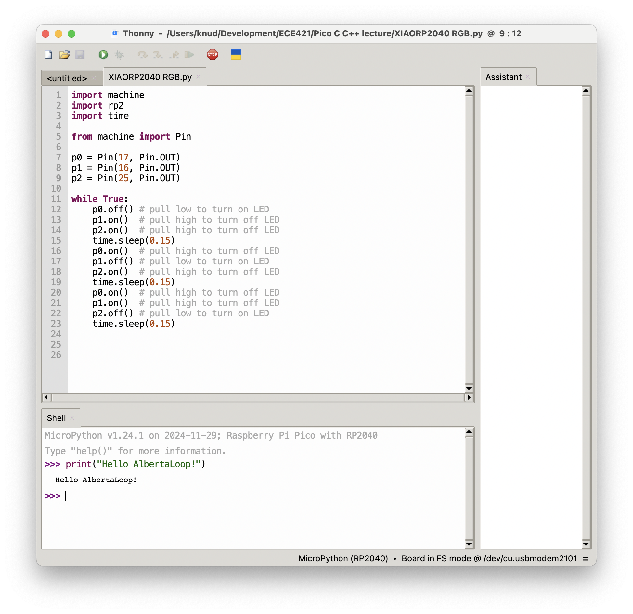
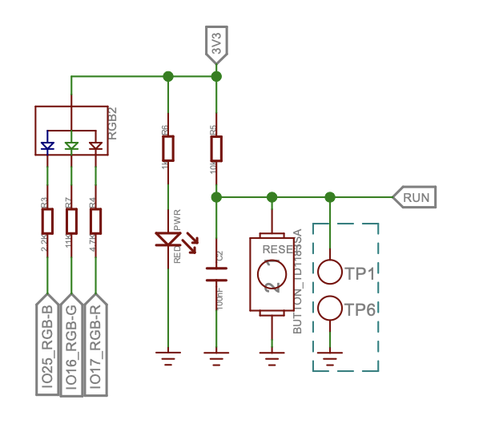
Simple RGB blinky

Slide 24
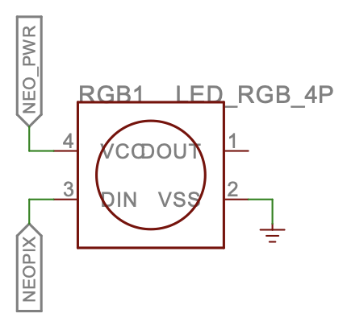
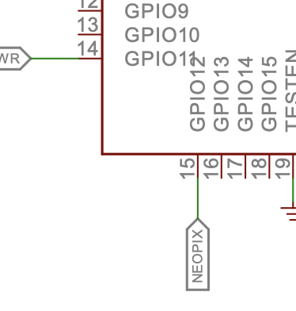
NeoPixel

Slide 25
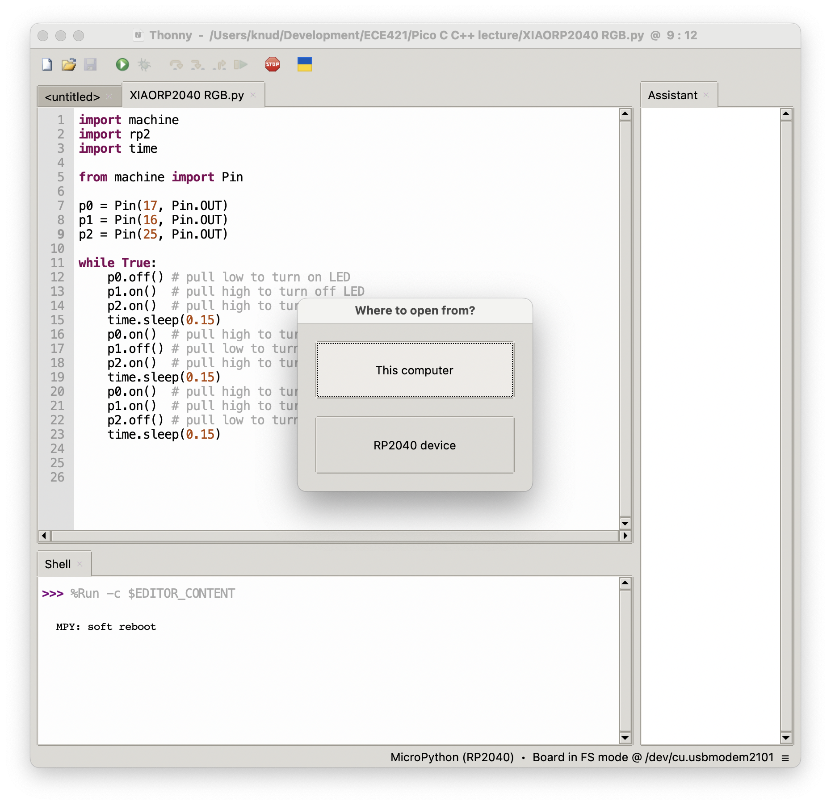
Load NeoPixel Library
ws2812.py

Slide 26
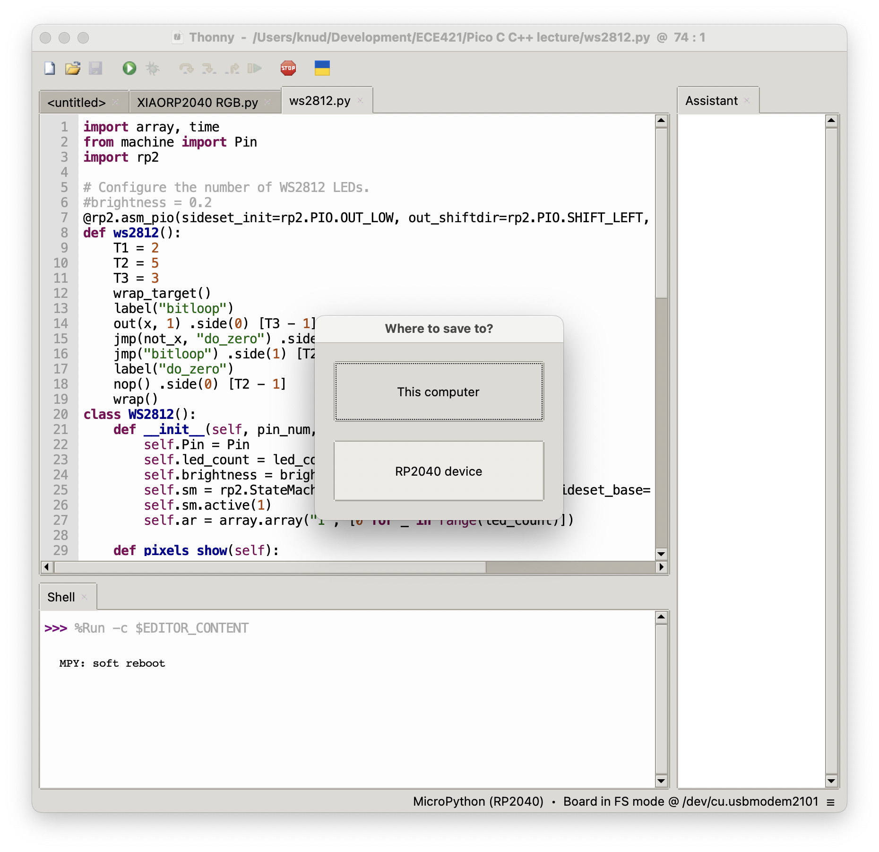
Save Library
Save As to the RP2040

Slide 27
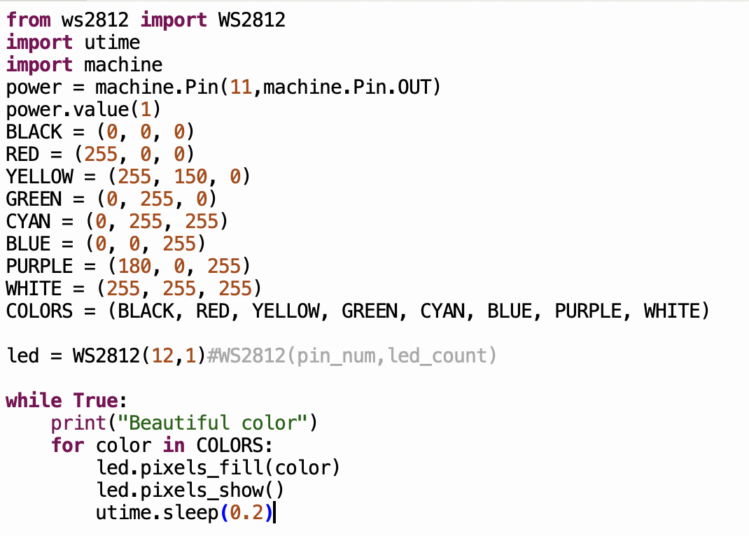
NeoPixel code
Save As to computer
or RP2040
Then run

Slide 28
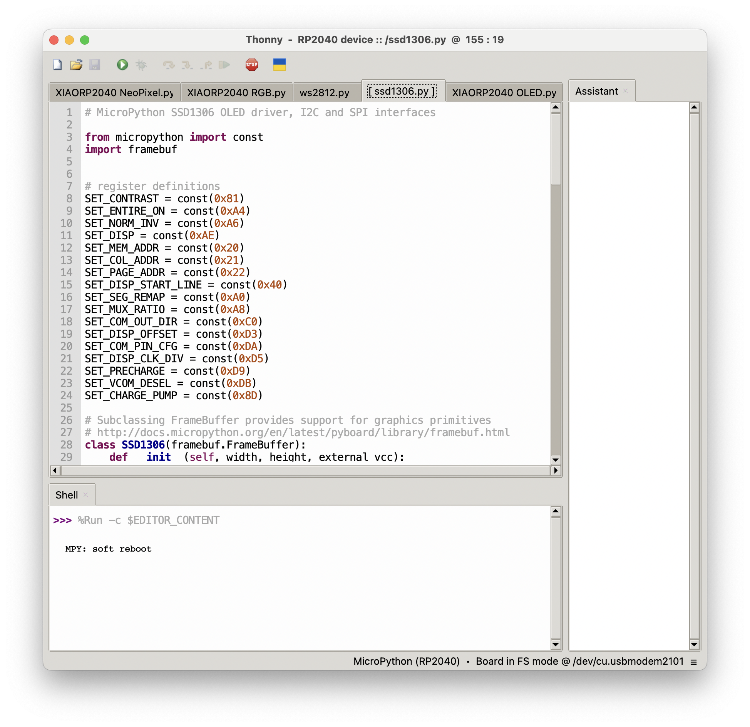
Load OLED Library
ssd1306.py
Save As to the RP2040

Slide 29
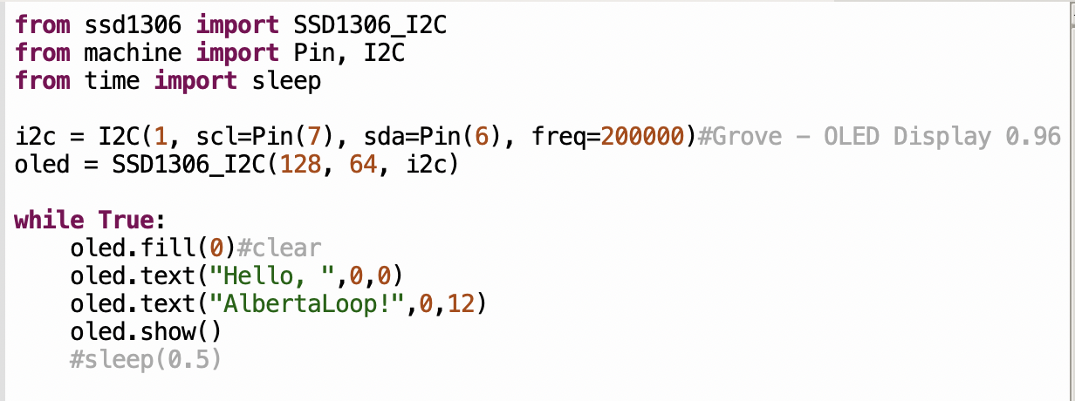
OLED code
Save As to computer
or RP2040
Then run

Slide 30
Analogue to Digital Conversion
ADC
•
•
•
N bits

Slide 31
XIAO RP2040 Pins

Slide 32
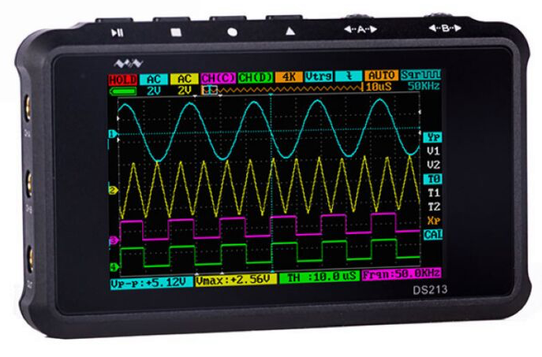
XIAO RP2040 Pins

Slide 33
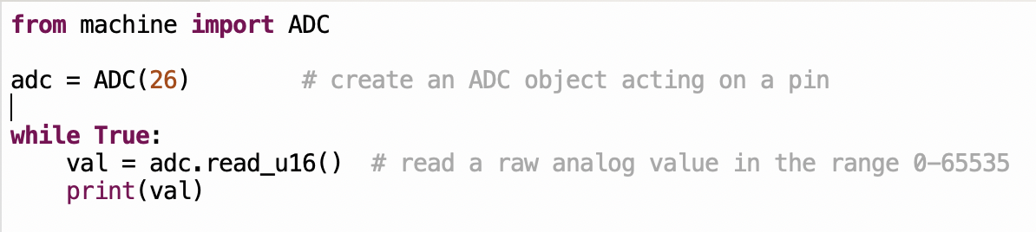
ADC code
Save As to computer
or RP2040
Then run

Slide 34
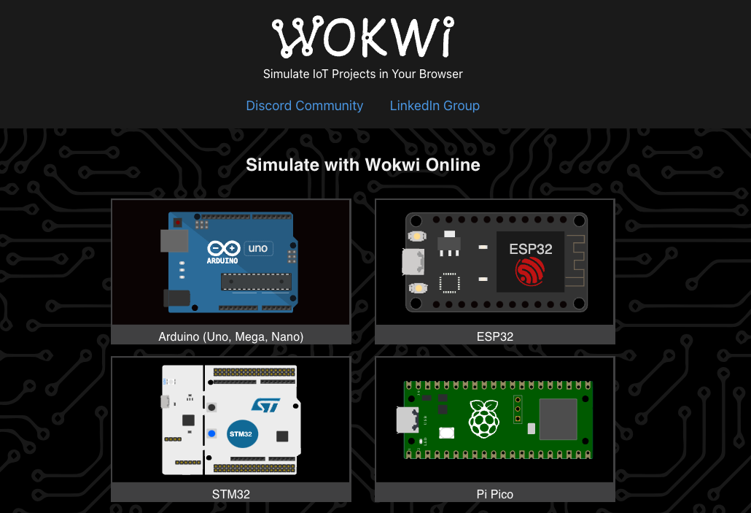

Slide 35
What is Wokwi.com? (from docs.wokwi.com)
Wokwi is an online Electronics simulator. You can use it to simulate Arduino, ESP32, STM32, and many other popular boards, parts and sensors.
Here are some quick examples of things you can make with Wokwi:
Arduino Uno "Hello World"
Blink an LED on ESP32
Monitor the weather on ATtiny85
Control 32 Servos with Arduino Mega
Animate an LED Matrix with FastLED
7 Segment Counter with MicroPython on ESP32
…and Pico!

Slide 36
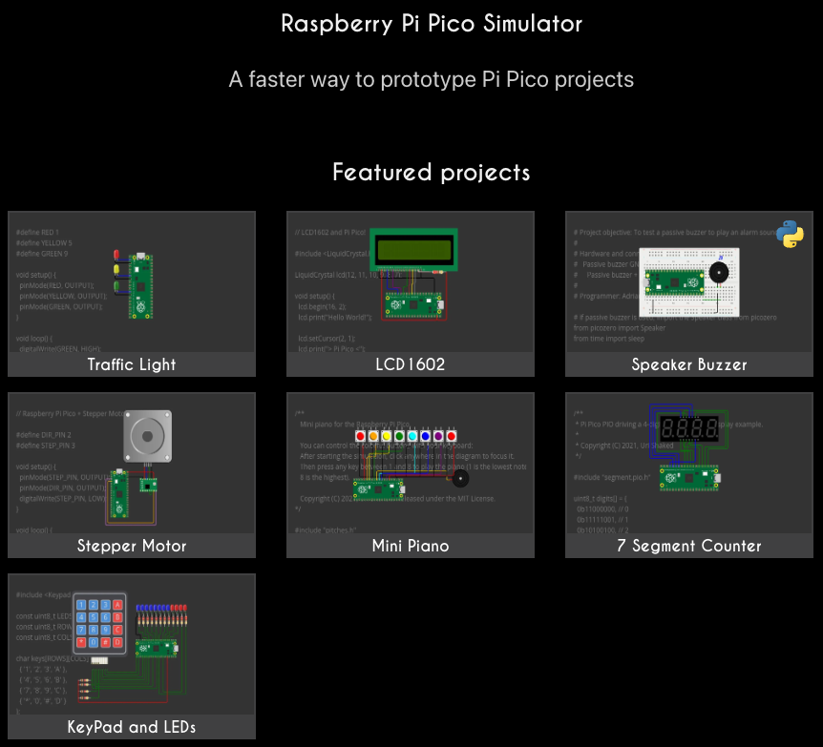

Slide 37
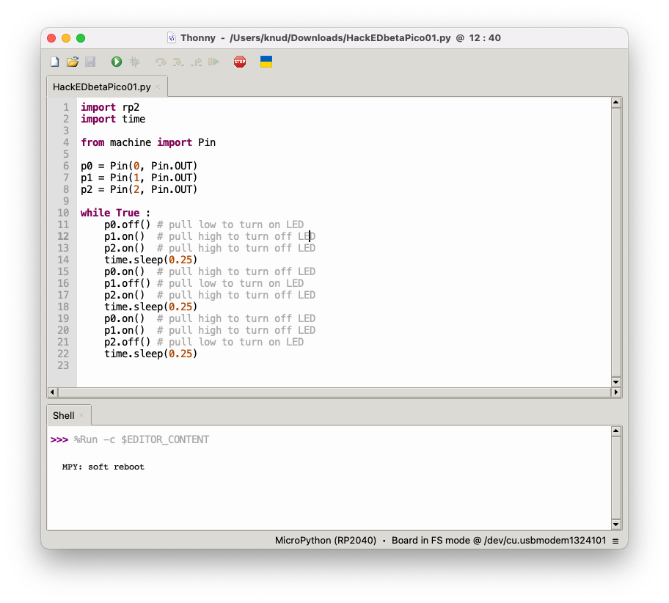
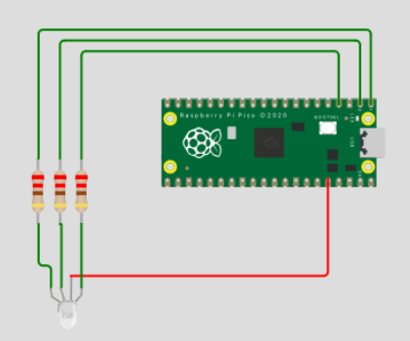
Simple RGB blinky

Slide 38
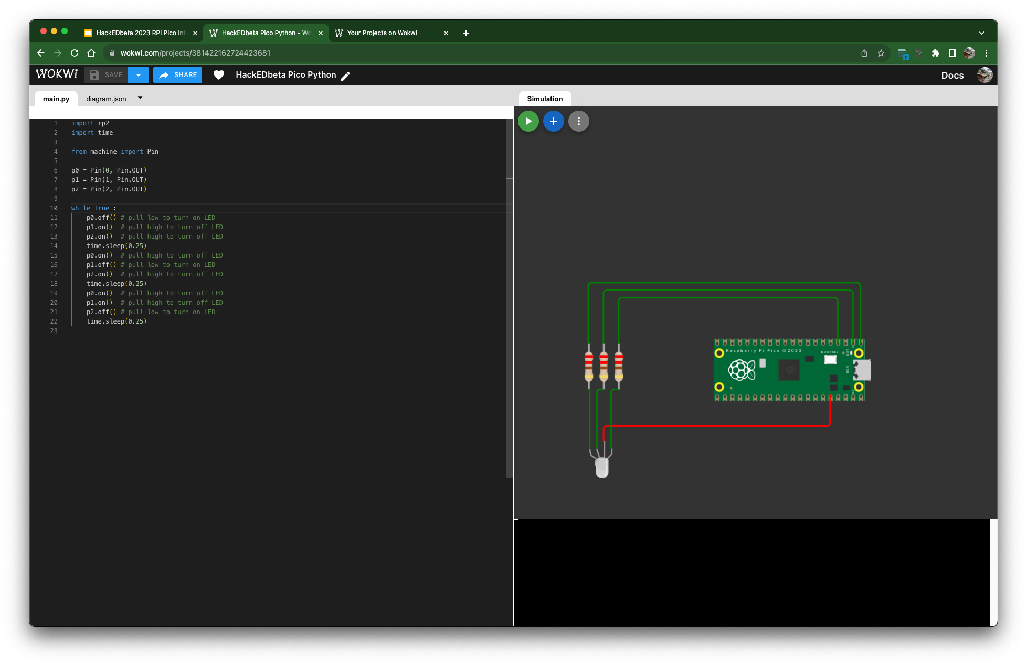
Wokwi Version

Slide 39
Trivia
...with wee prizes...

Slide 40
Trivia
What is an equivalent to the U of A’s main frame computer from the 80s?

Slide 41
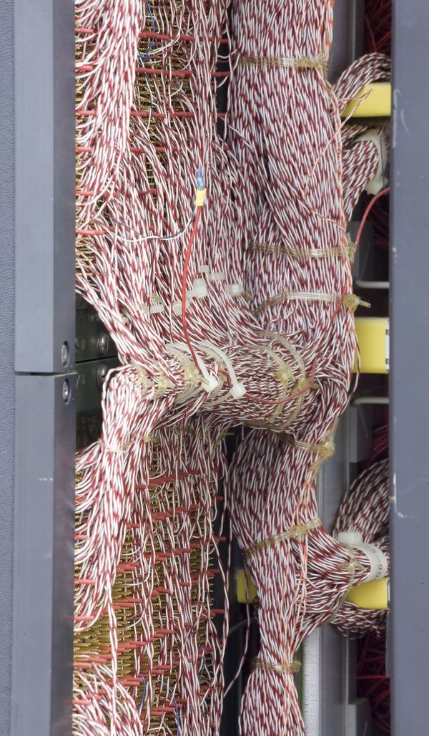
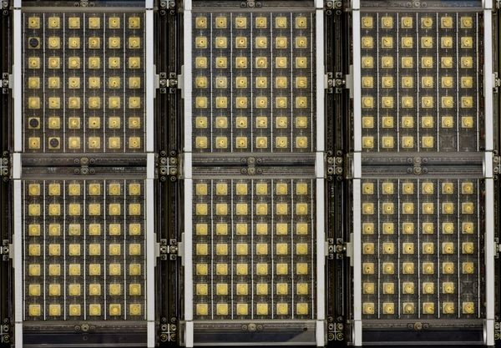
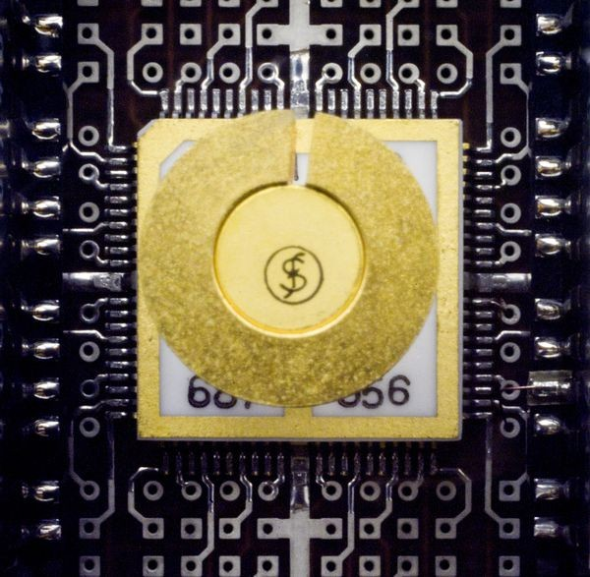
Amdahl 470 v/6
Date Introduced : 1975
Dimensions overall: 63” x 70” x 26”
Keywords : Clones; Plug compat; IBM
Speed : 3.5 MIPS
Memory Size : up to 8MB
Memory Width : 32-bit
Cost : $3,750,000 (2020 $17,981,250)

Slide 42
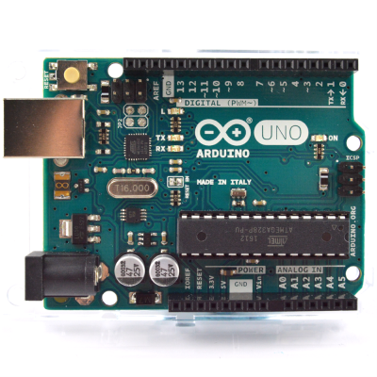
Arduino
Date Introduced : 2010
Dimensions overall: 2.7” x 2.1” x 0.6”
Speed : 8 - 11 MIPS
Memory Size : 32k FLASH 2k SRAM
Cost : ~$20
Cost to make : < $5

Slide 43
Trivia
What are the most loved and hated languages in the 2022 Dice survey
Notes:
https://www.dice.com/career-advice/20-programming-languages-that-developers-love-the-most

Slide 44
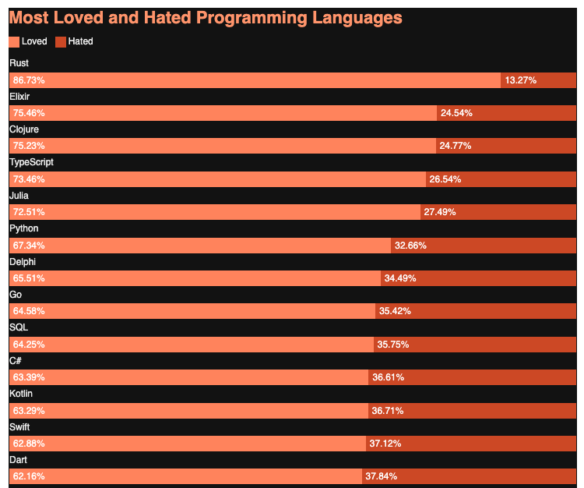
Most loved
Rust 86.83%
Elixir 75.46%
Clojure 75.23%
TypeScript 73.46%
Julia 72.51%
Python 67.34%

Slide 45
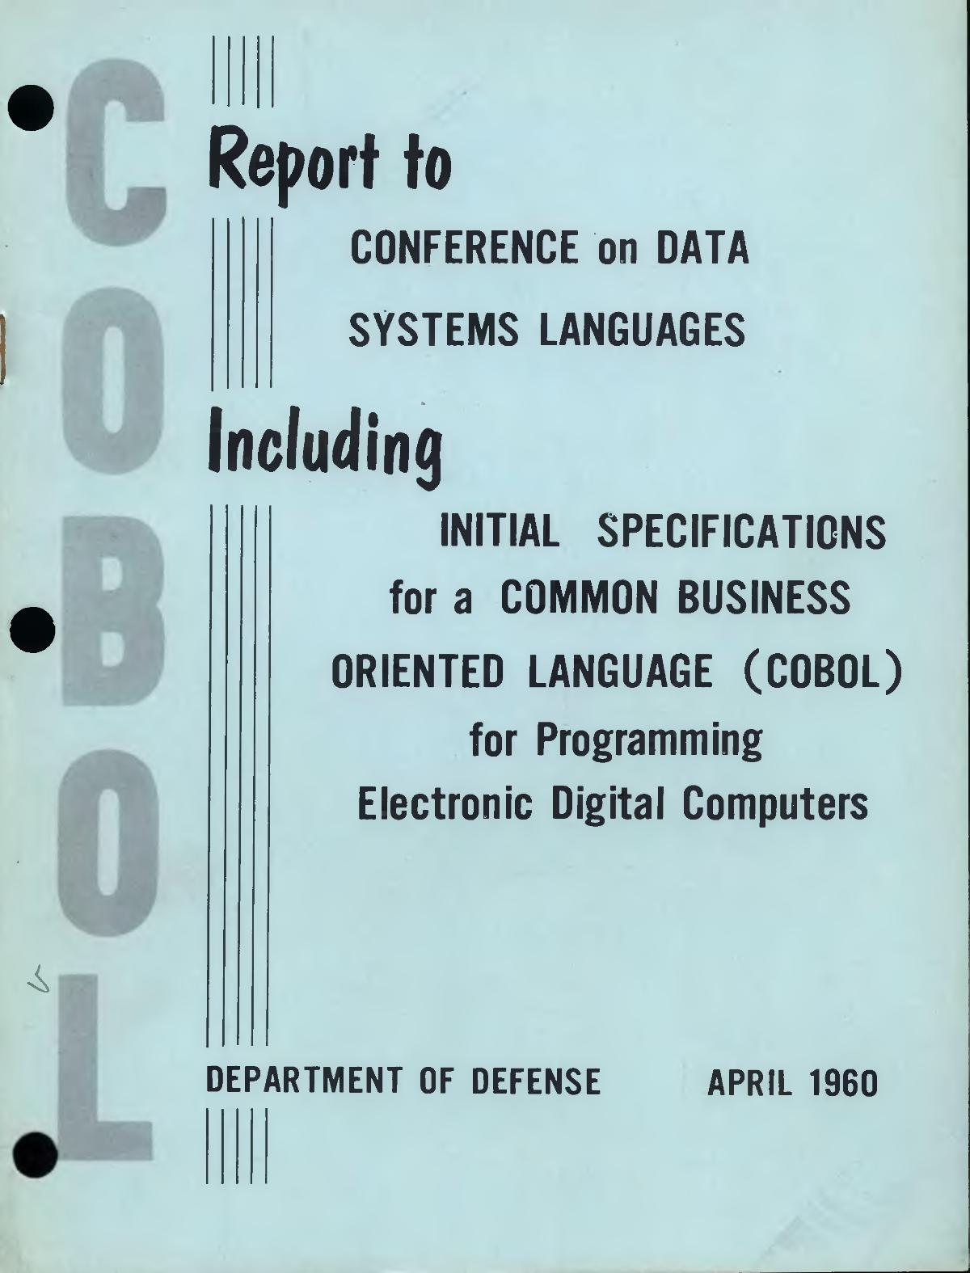
Most hated
VBA (78.56 percent).
COBOL (hated by 79.96 percent of developers)
MATLAB (80.84 percent), and

Slide 46
Most hated
VBA (78.56 percent).
COBOL (hated by 79.96 percent of developers)
MATLAB (80.84 percent), and

Slide 47
